Slide 1
Insights into Developing and Teaching an Academic Undergraduate Brewing Science Course at
Colorado State University
John (Jack) S. Avens, Ph.D.
Professor
Department of Food Science & Human Nutrition
Colorado State University
Fort Collins, Colorado
E-mail: jack.avens@colostate.edu

Slide 2
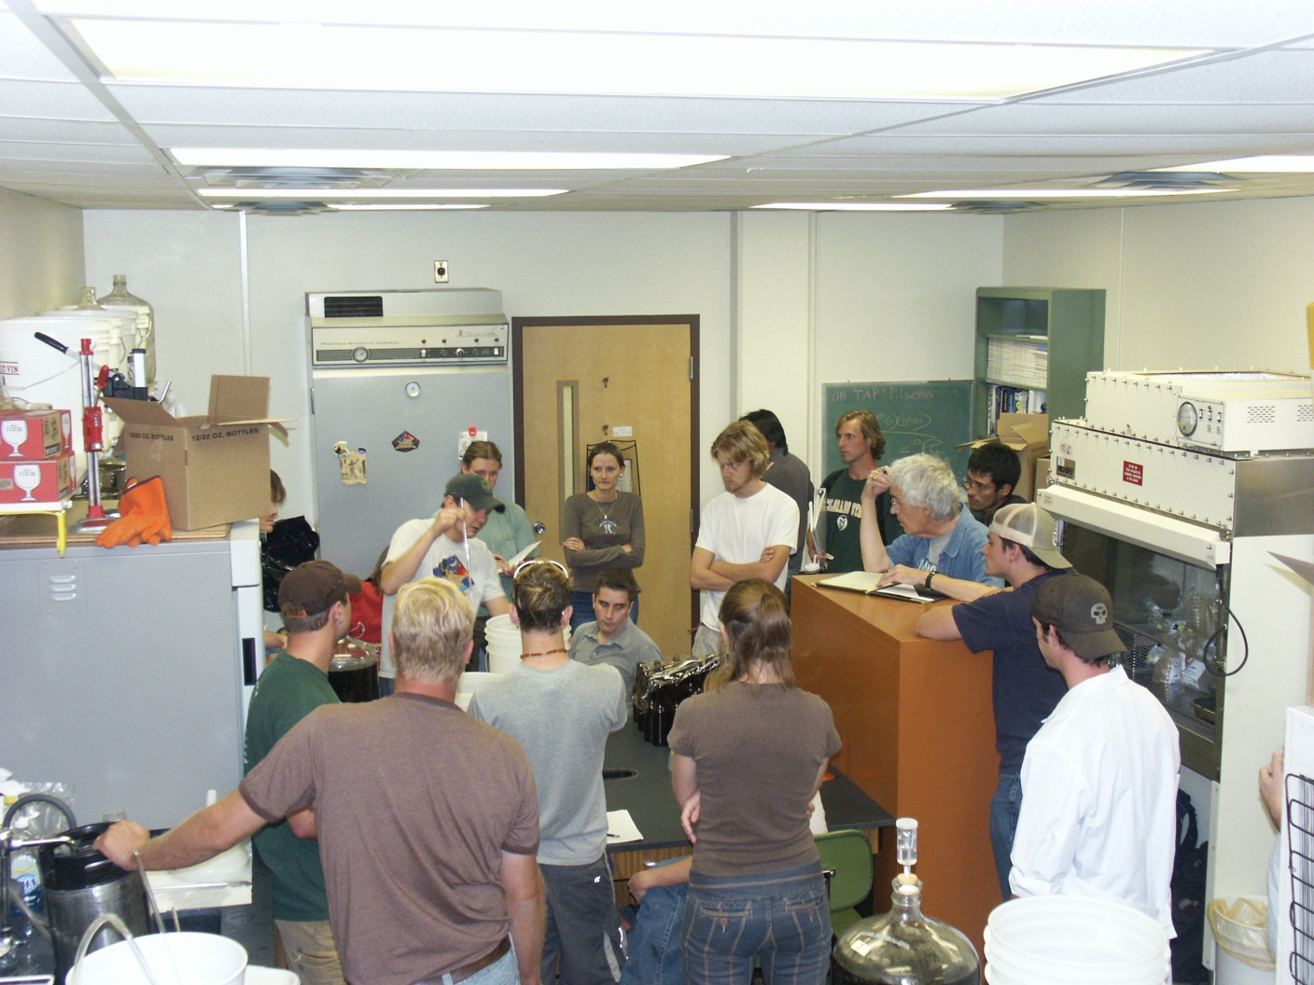
Brewing Science at CSU
2005- Jack Avens -2012
Department of Food Science & Human Nutrition

Slide 3
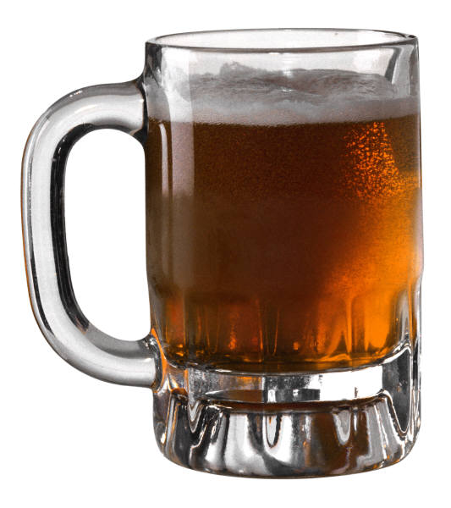






Brewing Science & Technology
FTEC 460
Spring Semester, 2012
3 Credits
Thursday, 3:00 – 5:00 p.m.
Friday, 3:00 – 5:00 p.m.
Learn how to:
brew, ferment, package, and evaluate
microbrewed style beers and ales.

Slide 4
FTEC 460 is an advanced undergraduate course in food processing, intended for the senior science major with career interests in applied science.
It is about science applied through technology to commercial brewing of ales and lagers.
It is not about home brewing and beer drinking.
It is intellectually challenging and time and effort demanding.

Slide 5
TARGET STUDENT ENROLLMENT
Students will be multidisciplinary, will have completed 60 semester credits (Junior or Senior), and will be 21 years of age.
PREREQUISITE
Fundamentals of Organic Chemistry
TEXTBOOK
Lewis, M. J. and T. W. Young. 2004. Brewing. Second Edition. Springer Science + Business Media, LLC , New York. (required)

Slide 6
Pedagogy
Instructional methods to facilitate student learning:
Textbook
In-class topic presentations:
  instructors
  topic experts
Laboratory:
  hands-on “brewing”
  sensory evaluation
  laboratory reports
Field trips to commercial breweries
  detailed tours of facilities
  hands-on “brewing” for public sale
  subsequent tapping events

Slide 7






Instructors
Jack Avens, CSU Professor of
Food Science
Kevin Davis, CSU Affiliate Faculty
Brewer, New Belgium Brewing Co.
Brewmaster
North Country Community College
Saranac Lake, NY
Master Brewer Program
U. California - Davis
Dan Strevey, CSU Graduate Teaching Assistant
Brewer, Avery Brewing Co.
Brewmaster
BS – Health & Exercise Science
Colorado State University
Tony Rau, CSU Undergraduate Teaching Assistant
Intern, Odell Brewing Co., Fort Collins
Brewmaster

Slide 8


What do students do?

Slide 9
Grading
30% - laboratory reports, 3 due throughout semester, 10% each
50% - 5 exams sets, due throughout semester, 10% each set
20% - comprehensive practical examination

Slide 10
Topics Presented
beer style guidelines
ingredients
alcoholic beverage laws and policies
heat transfer and refrigeration
cleaning and sanitation
malting technology
mashing technology
brewing calculations
wort boiling and cooling
yeast propagation

Slide 11
Topics Presented
fermentation process and technology
finishing processes
beer packaging and dispensing
sensory evaluation
_______________________________________
beer flavor and off-flavors
malting and mashing biochemistry
hop biochemistry
commercial hop production
fermentation biochemistry

Slide 12
Topics Presented
_______________________________________
quality control in brewing
special beer topics
careers in the brewing industry
world brewing industry
world beer varieties and styles

Slide 13
Guest Presentations in Class
Oskar Blues Brewery, Longmont
Grimm Brothers Brewhouse, Loveland
Avery Brewing Co., Boulder
MillerCoors and Blue Moon Brewing Co., Golden
Anheuser-Busch InBev, Fort Collins

Slide 14
Lab Activities
milling
mashing
lautering
sparging
boiling
cooling
oxygenating
fermentation
conditioning
bottling or kegging

Slide 15
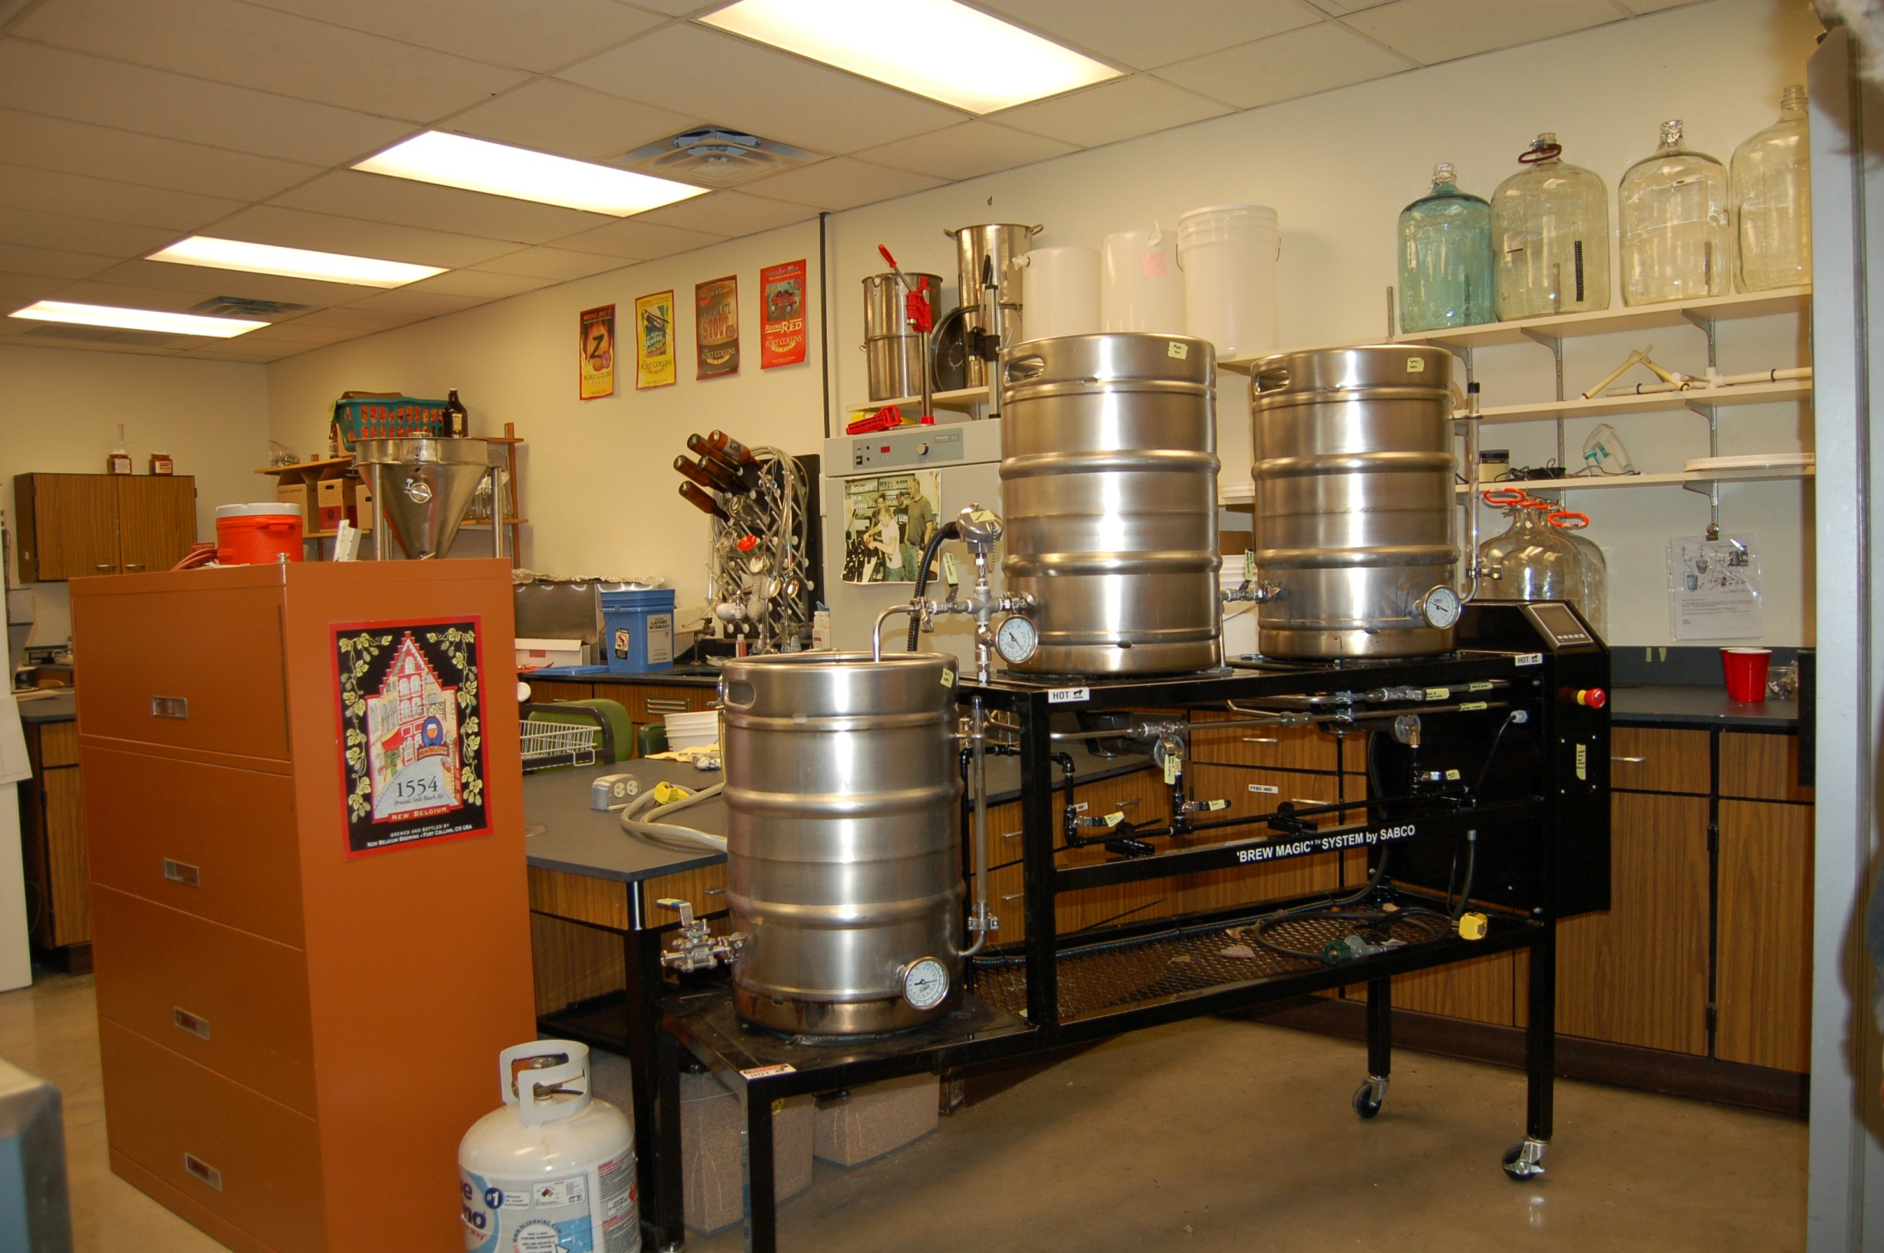

Slide 16
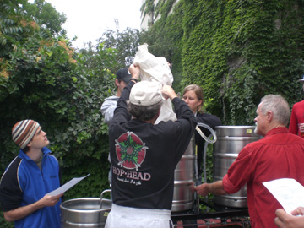
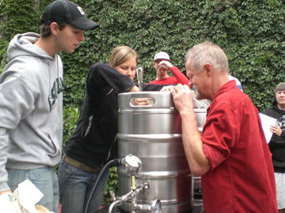
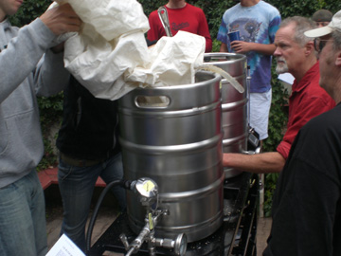
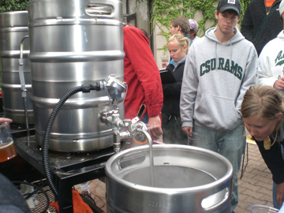

Slide 17
Field Trips in Fort Collins
CooperSmith’s Brewing Co.
C.B. & Potts / Bighorn Brewing Co.
Crooked Stave Artisan Beer Project
Pateros Creek Brewing Co.
The Fort Collins Brewery
New Belgium Brewing Co.
Anheuser-Busch InBev

Slide 18
Field Trips to Brew in Fort Collins
Equinox Brewing Co.
Funkwerks Brewery
Odell Brewing Co.

Slide 19
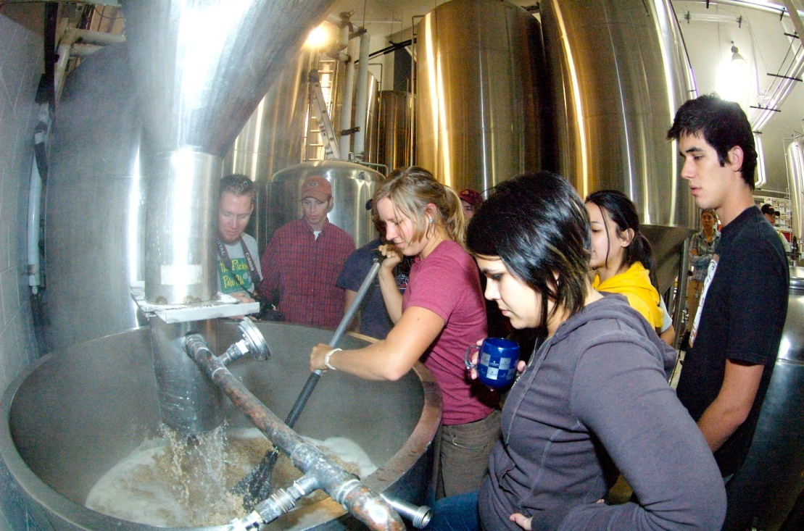
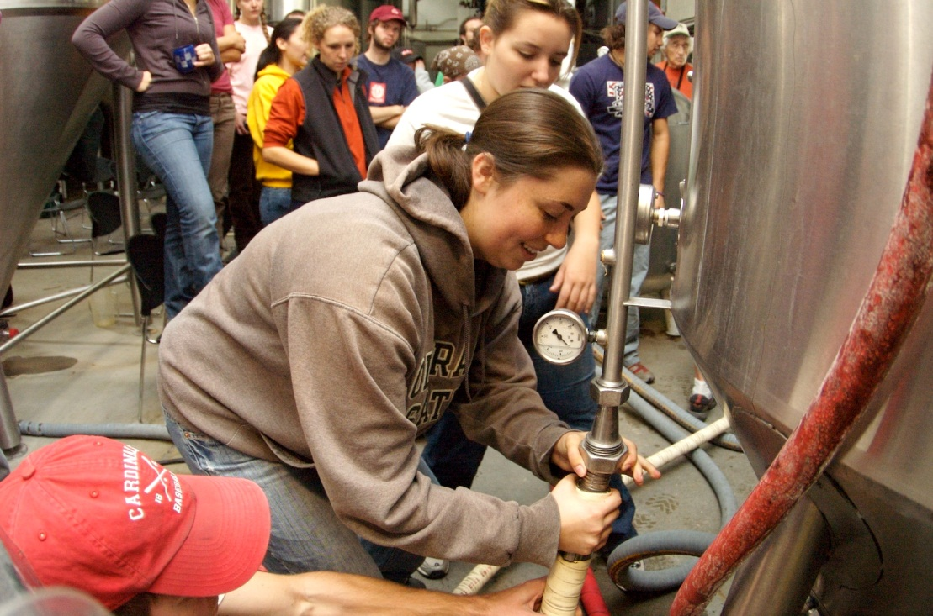
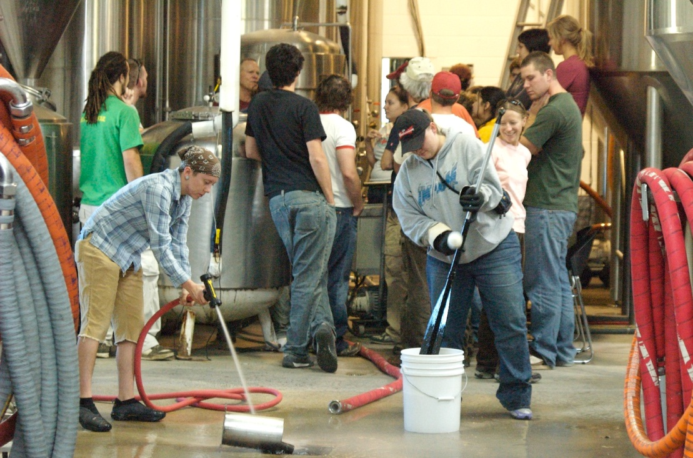
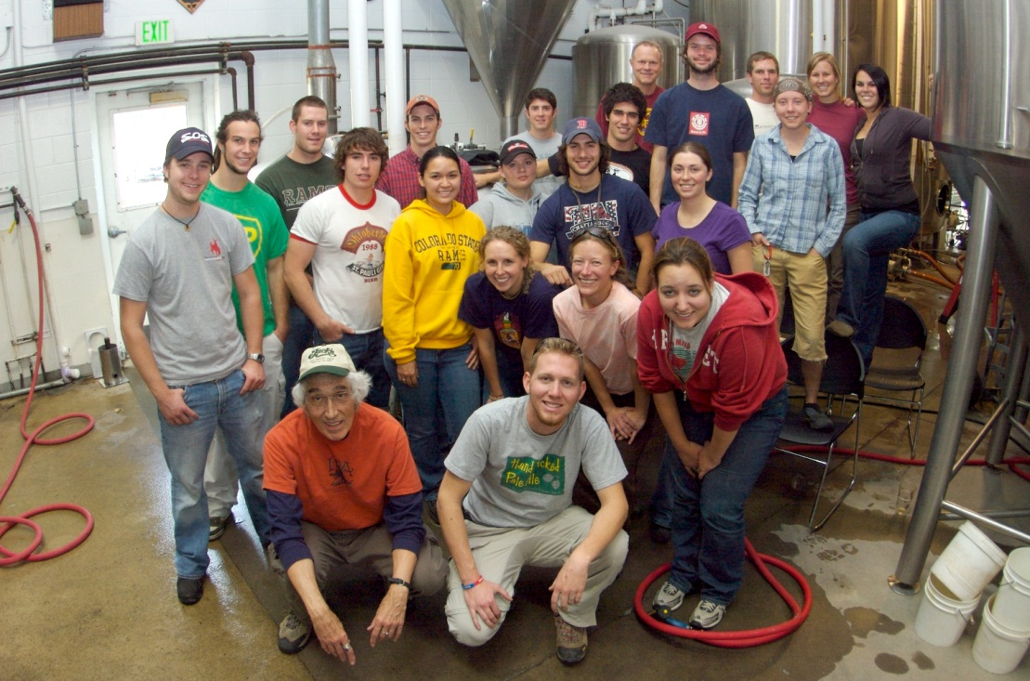
Odell Brewing Company

Slide 20
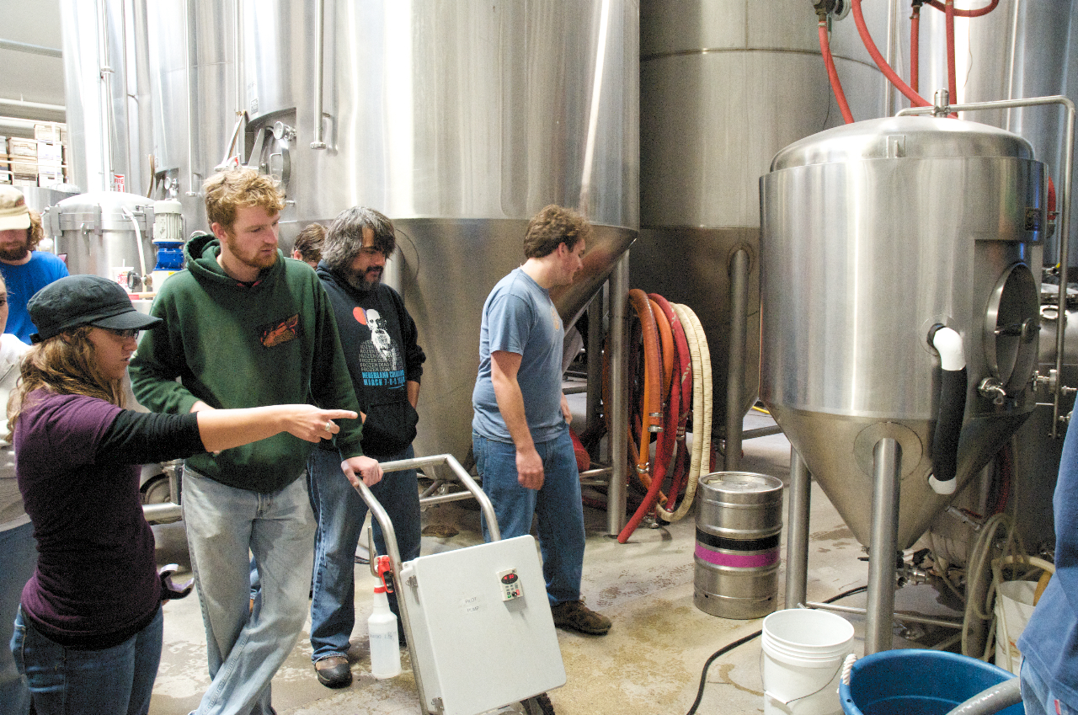
Class brewing on Saturday at Odell Brewing Company

Slide 21
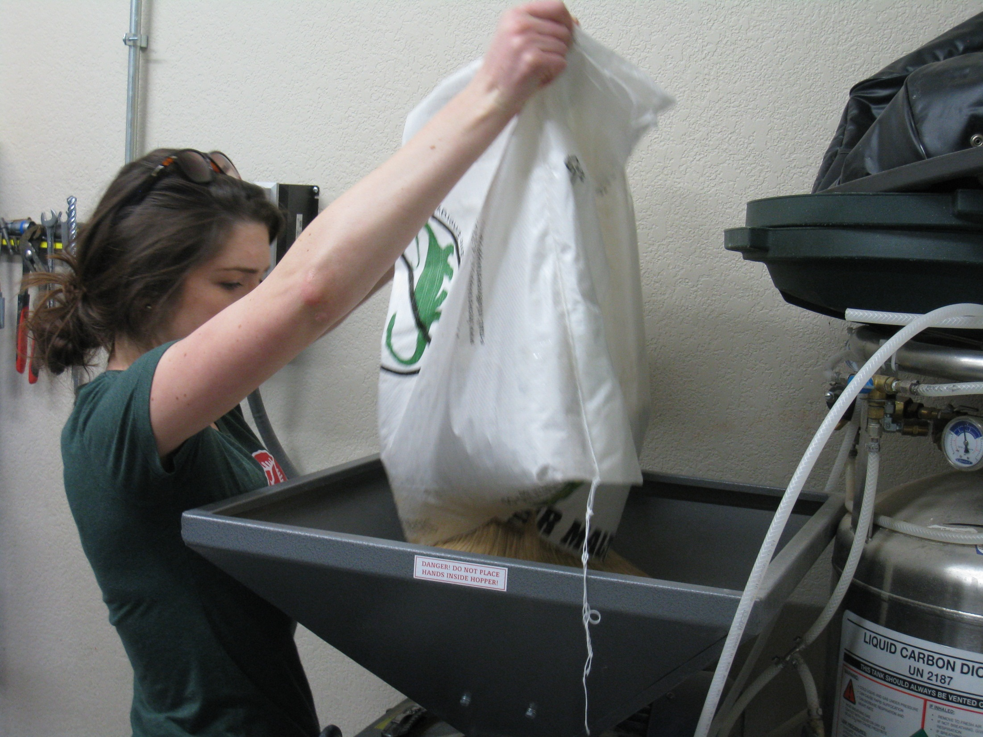
Equinox Brewery:
milling barley

Slide 22
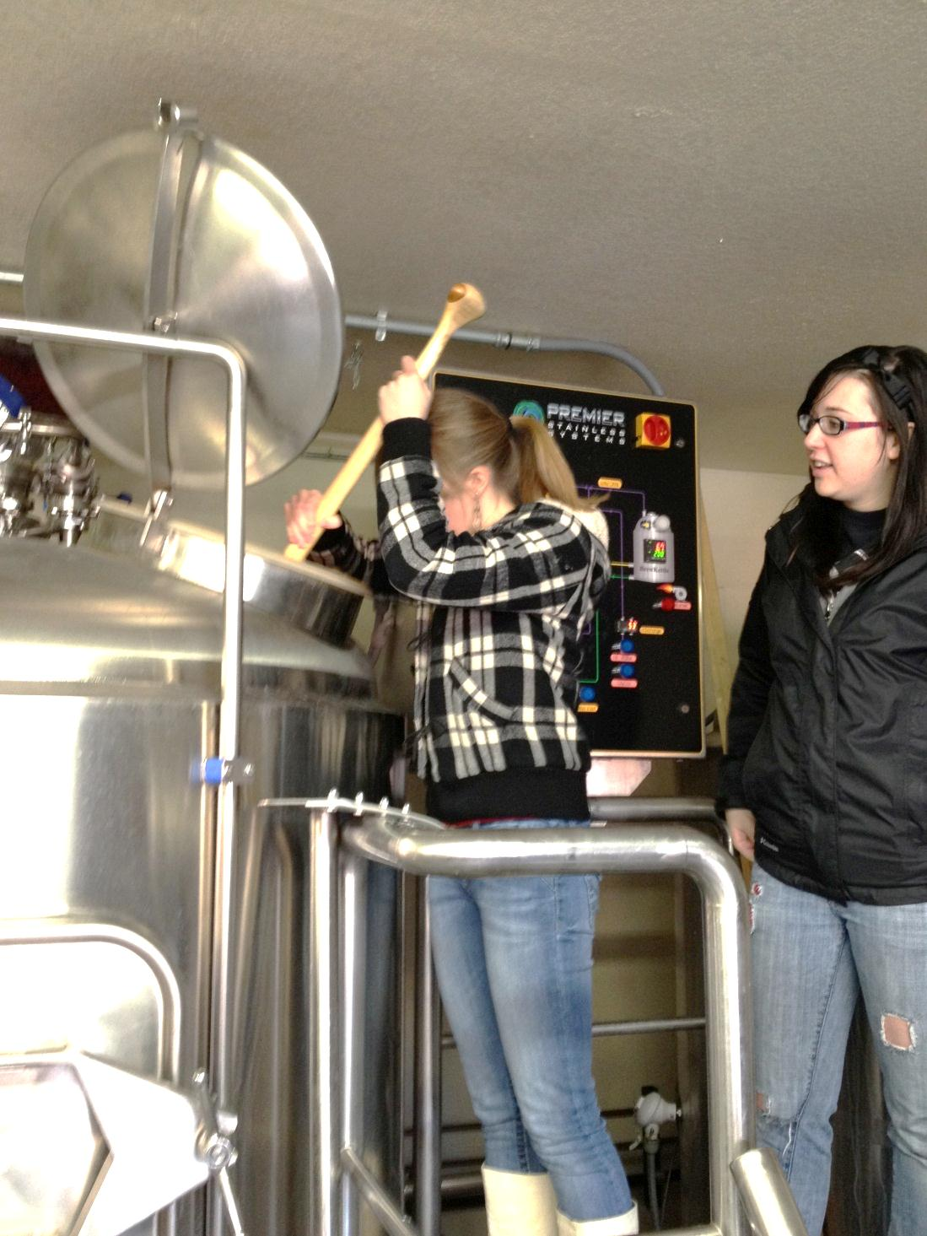
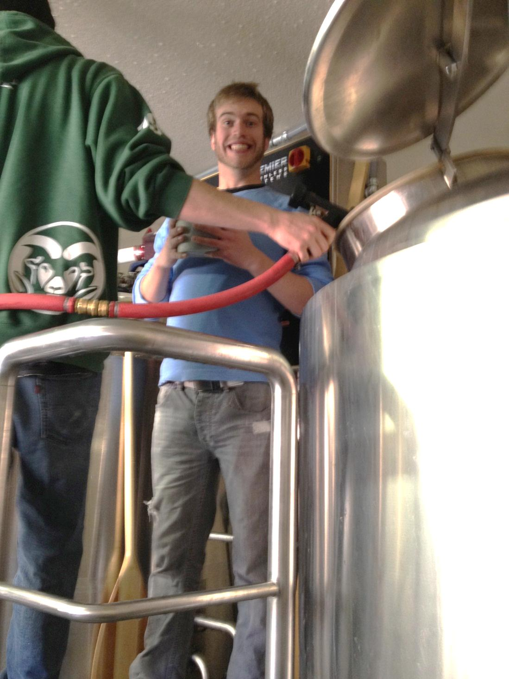
mashing in kettle boil

Slide 23
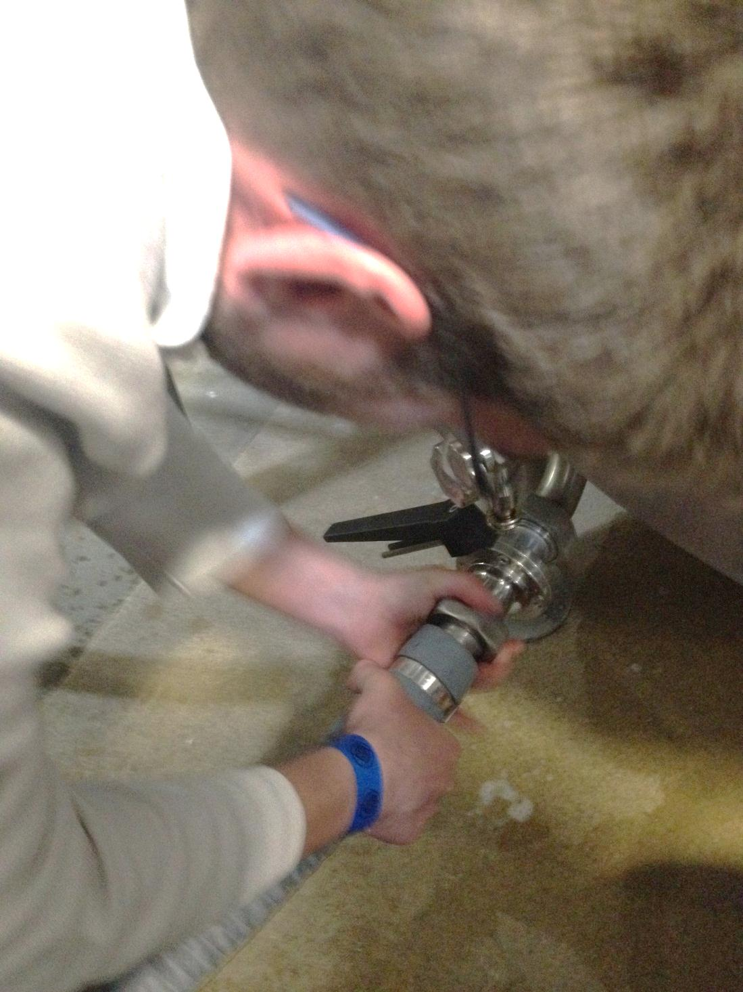
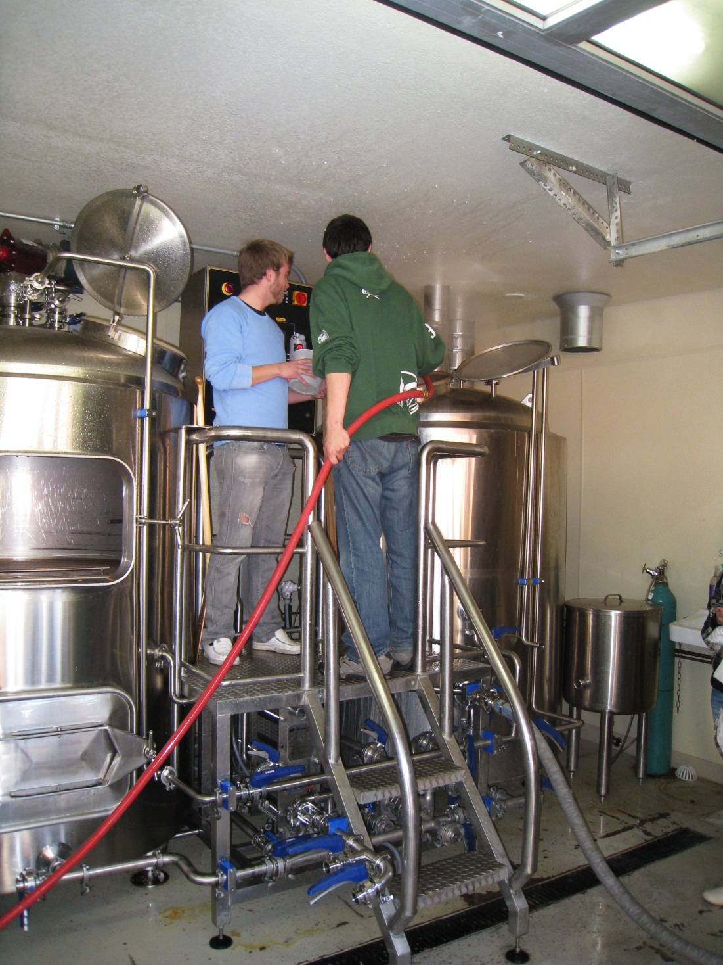
hose connections kettle boil

Slide 24
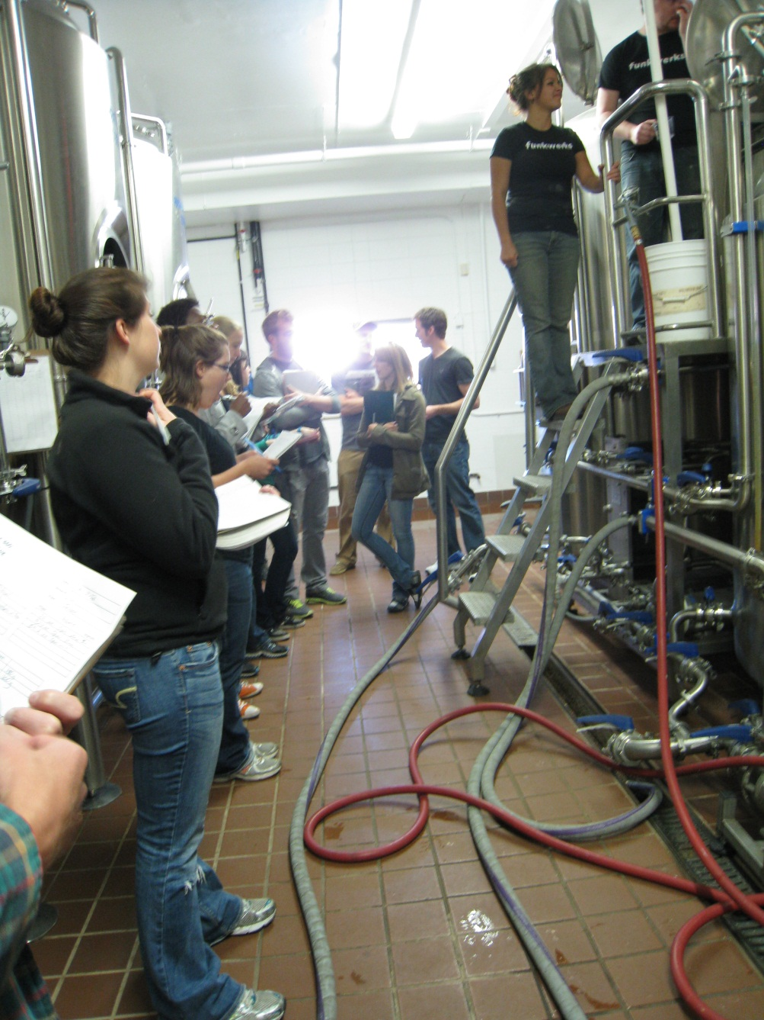
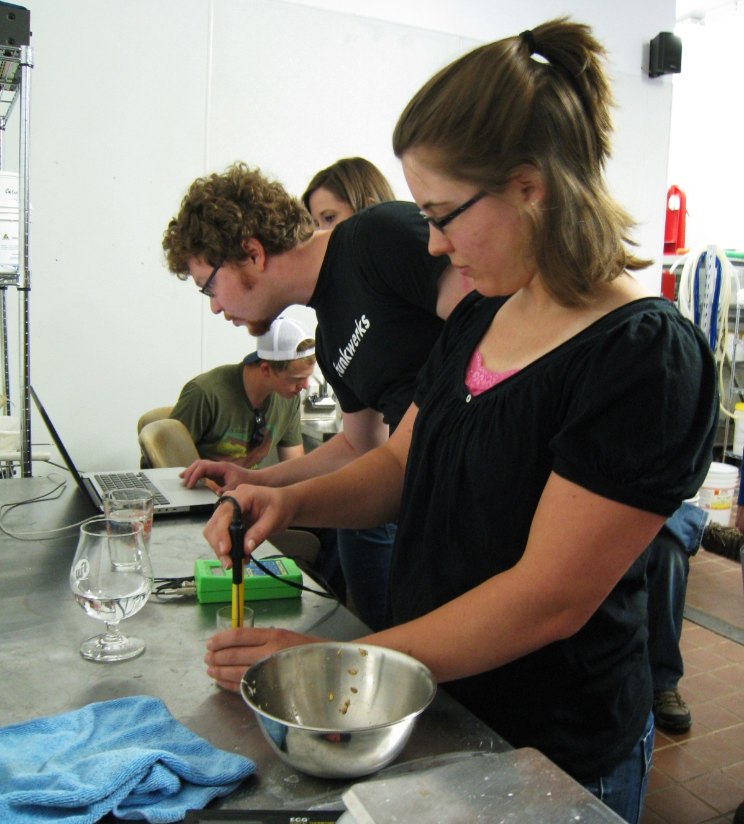
Funkwerks:
the brewery the lab

Slide 25
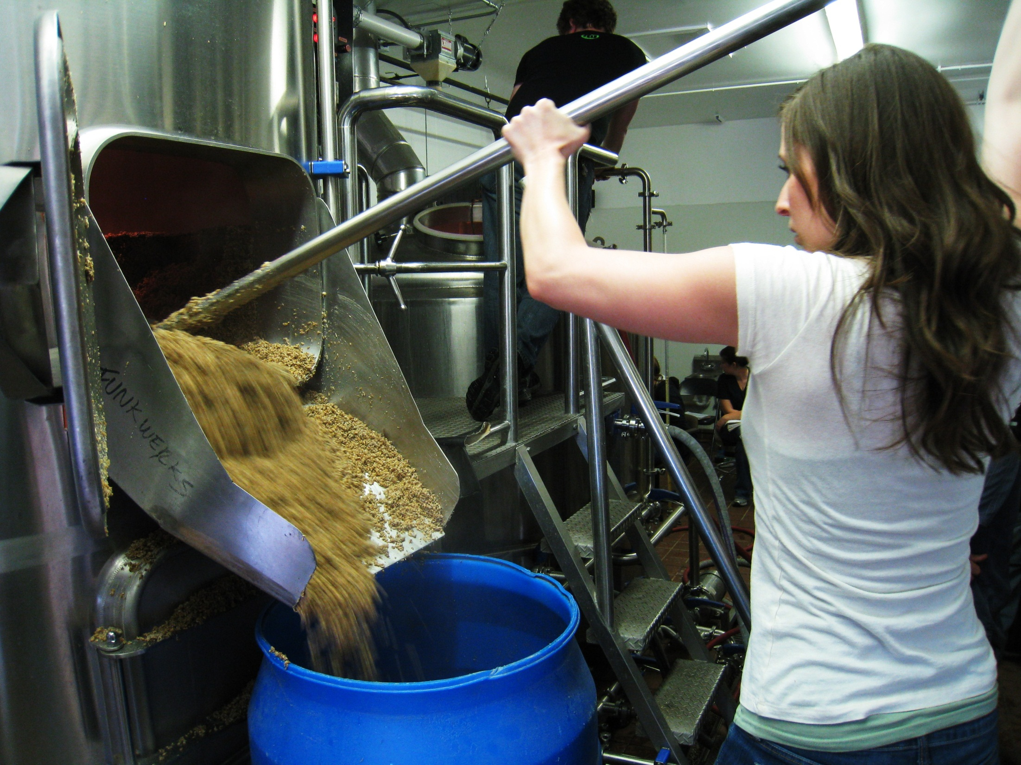
Mash tun:
spent grain

Slide 26
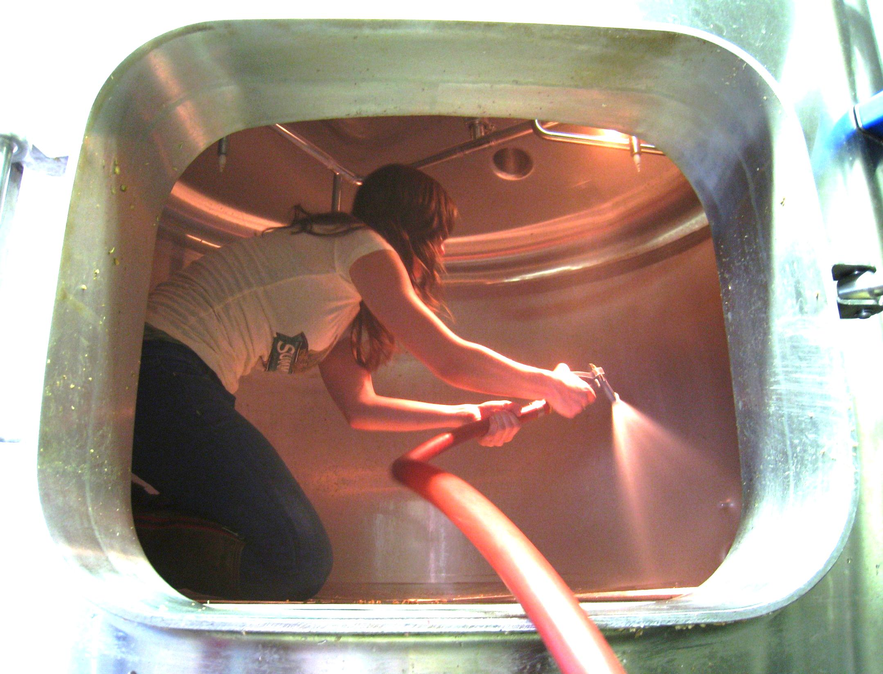
Mash tun:
“clean in place”…NOT

Slide 27
Breweries Involved in FTEC 460
* New Belgium
* Odell’s
* Anheuser-Busch In Bev
* Fort Collins Brewery
CooperSmiths
* C. B. & Potts
* MillerCoors
* Equinox
* Avery
* Funkwerks
Crooked Stave Artisan Beer Project
Grimm Brothers
Pateros Creek
* Oskar Blues
* Breweries that have hired FTEC 460 graduates

Slide 28
Enrollment & Student Interest
2005 – 2012: 11 semesters, 220 students
32 have been hired by brewing industry (15%)
Enrollment cap at 20 per semester
Currently 40 qualified students per semester cannot enroll once cap is reached; huge demand for course.

Slide 29
Student Majors Enrolled
Food Science
Biological Science
Biomedical Sciences (pre-med)
Botany
Microbiology
Zoology
Natural Sciences
Chemistry
Biochemistry
Physics
Chemical Engineering
Chemical & Biological Engineering
Mechanical Engineering
Computer Engineering
Civil Engineering
Environmental Engineering
Systems Engineering
Nutrition/Dietetics
Restaurant & Resort Management*
Health & Exercise Science
Environmental Health
Wildlife Biology
Rangeland Ecology
Horticulture
Soil & Crop Sciences
Forestry
Ecology
Entomology
Psychology
Sociology*
Political Science*
History*
Business Administration*
Economics*

Slide 30
CSU Courses in Fermentation Science
FTEC 210 Science of Food Fermentation
FTEC 460 Brewing Science & Technology
FTEC 422 Brewing Analysis & Quality Control
FSHN 484 or FSHN 684, Supervised College Teaching (of fermentation science courses)
FTEC 487, Internship (brewing/food industry)
FTEC 495, Independent Study (research)

Slide 31
Summary
Challenges
demand of brewing industry and students
courses limited to students age 21
maturity level and personal philosophy on alcohol use and abuse – students written statement
support from administration
Benefits
industry interest and support
student interest and career opportunities
platform for teaching food science
Educational Techniques
involving commercial brewers and breweries
hands-on brewing experience: lab/breweries/internships

